Slide 1
M.O.M Campaign
Chin Ying Qi
Khoo Jing Yu
Nur Naziha
Nur Shafiqa
Yvonne Yu
Notes:
JY
Story and bring through content page

Slide 2
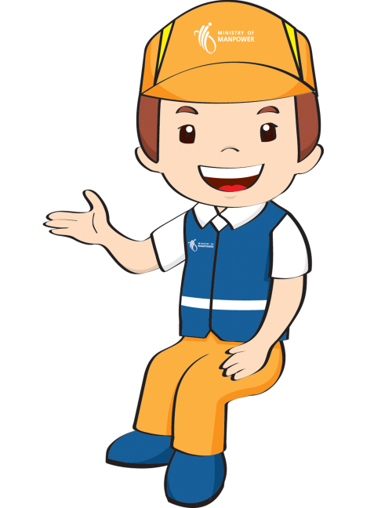
Our Objectives
Create and maintain the bridge between M.O.M and the FWs in Singapore
Educate about the employment regulations, their rights and responsibilities
Increase the number of visitors to the M.O.M Roadshow 2014
Notes:
JY
Educate about the employment regulations, their rights and responsibilities as well as welfare messages
Create and maintain the bridge between M.O.M and the foreign workers in Singapore
Increase the number of visitors to the MOM Roadshow 2014

Slide 3
Situational Analysis
Notes:
JY

Slide 4
Strengths
Strengths
→ Held past events before
Managed to reach out to a good amount of people who turnout at the previous road shows
→ Have already put up posters and have ready-made messages (E.g. REST WELL, WORK WELL etc.)
Created Ming, the mascot for entertainment and connecting the bridge between Foreign workers and MOM purposes
→ Prevent them from being bullied by employers as POLICIES were set and implemented to protect the rights of Foreign workers
Threats
→ No control on whether TA will want to spend their weekends at the road show
→ Due to the recent riot cases, the general public might discriminate on foreign worker (which might cause more difficulties for MOM to reach TA)
MOM needs to soften image*
Weaknesses
Past efforts do not seem to be working
Used the wrong approach in the past (aggressive and forceful/ SMS and flyers – limited)
Ming, not made use of in other *
→ TA are intimidated by MOM (see MOM being more authoritative)
→ Miscommunication between MOM and foreign workers
Opportunities
→ Total foreign workforce accounts for nearly 40% of SG’s total workforce in 2012 – there is an increase in the amount of employees needed to be taken care of
→ Foreign workers becoming more media savvy than what we thought*
→ TA able to afford data plans by purchasing prepaid card
Weaknesses
Opportunities
Threats
Notes:
JY
TAKE OUT MAIN POINTS!! **
*That is why we feel that more could be done with Ming
*Language barrier, different level of understanding – because of the gap they have in-between each other and how different groups of TA takes in information differently
*we decide to reach them on a personal level - recommendations

Slide 5
Audience Analysis
Notes:
JY

Slide 6
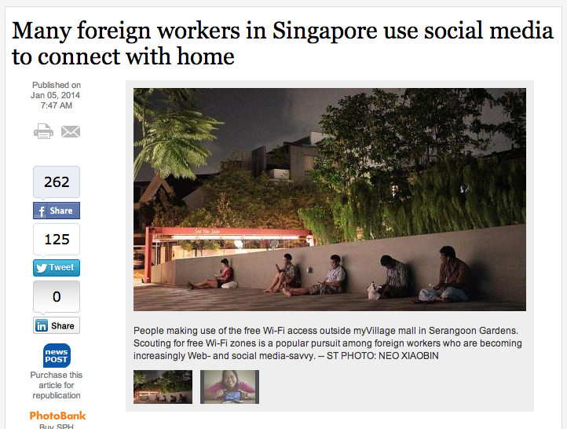
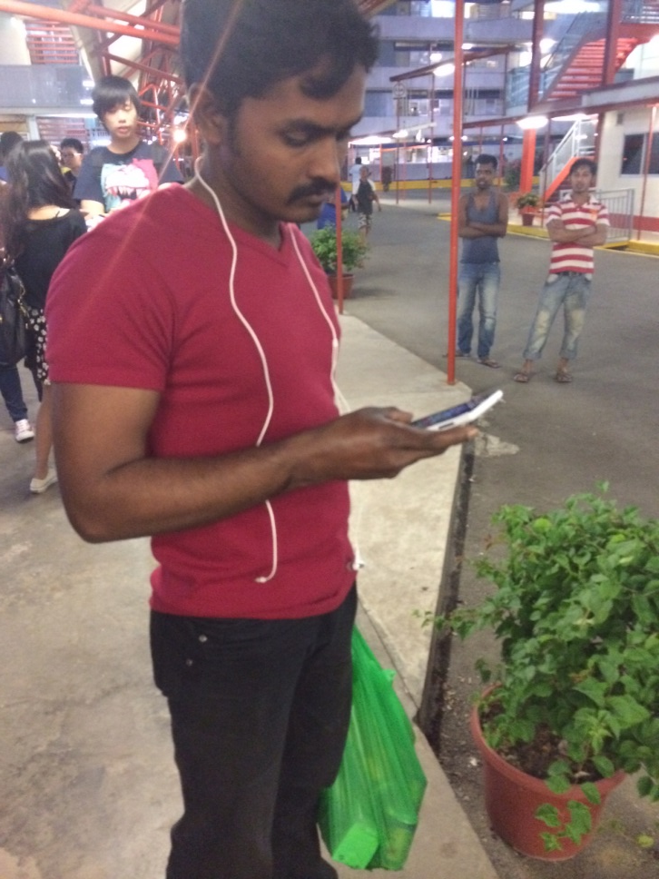
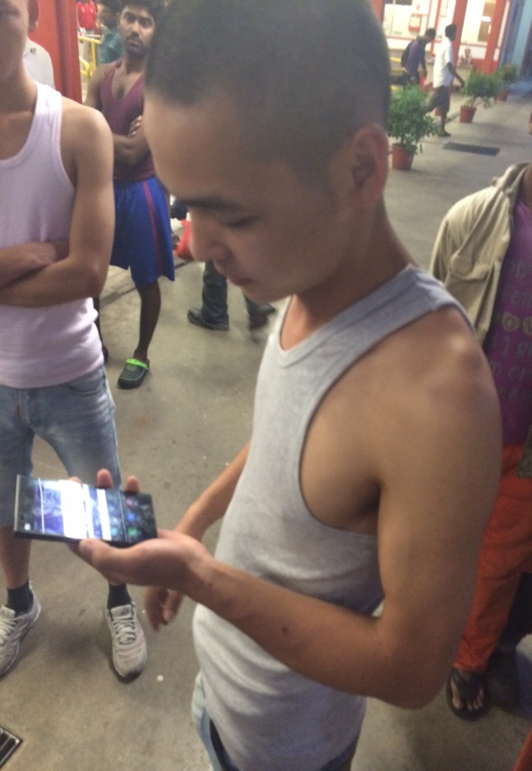
Notes:
Yvonne

Slide 7
Key Message
Notes:
Yvonne

Slide 8
Objective #1:
Create and maintain the bridge between MOM and the foreign workers in Singapore
Notes:
NN

Slide 9
Why do we need Ming as the ‘bridge’?
To Create brand identity for M.O.M
Associate Ming as part of M.O.M campaign
Current use for Ming?
Only for roadshows but not on other publicity tools
Notes:
NN
Currently only used for roadshow but not on other publicity tool
People would associate Ming as part of MOM campaign and motivate people to pay more attention while sending out message clearly

Slide 10
Use of mascots in Singapore
Water Wally
Active Years: 2005 to 2009
Mission: To promote conservation of water
Owner: Public Utilities Board (PUB)
Captain Green
Active Years: 1990 to 1997
Mission: To encourage clean and green lifestyle
Owner: Ministry of Environment
Creator: Ogilvy & Mather
Notes:
NN

Slide 11
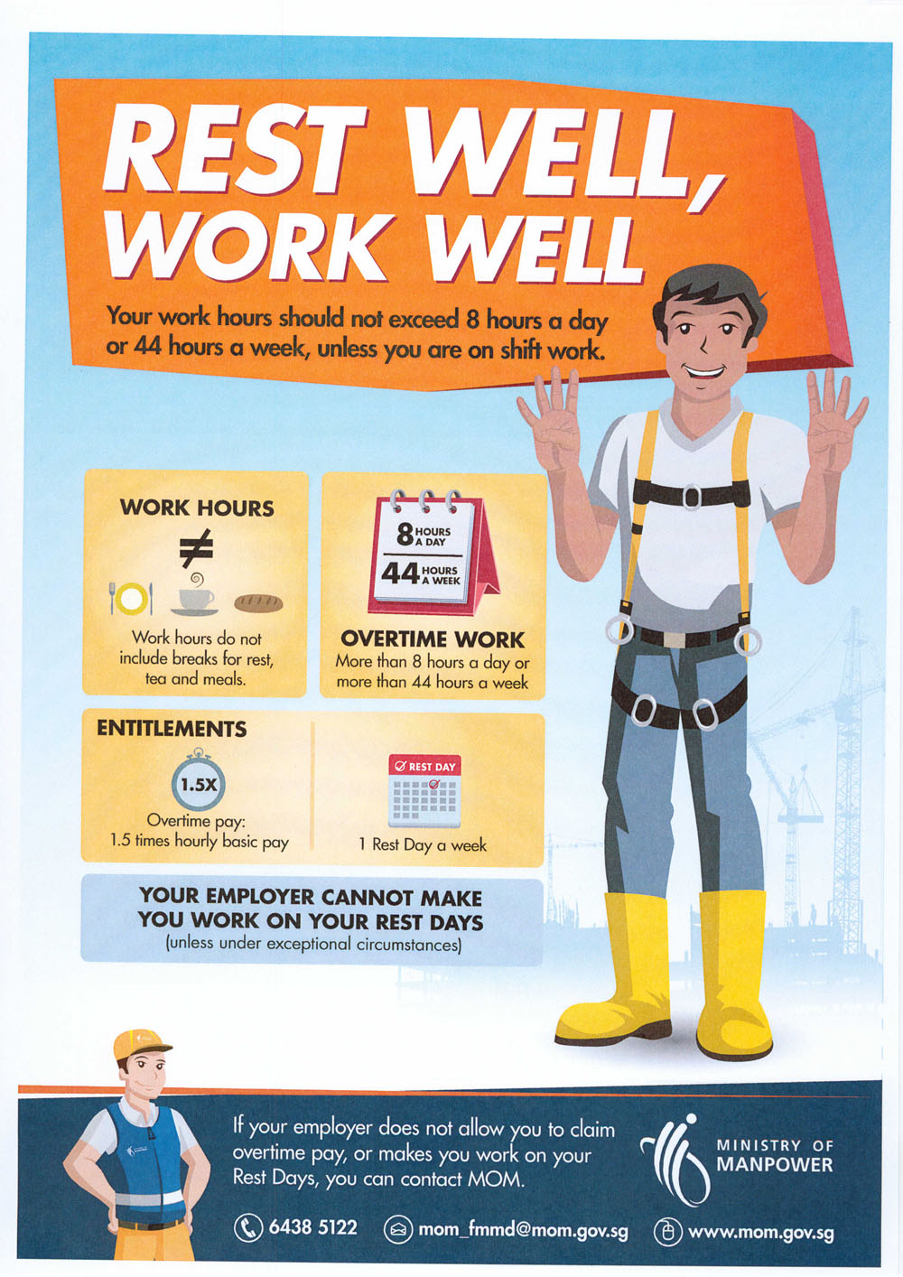
Revamp Current Posters
Notes:
NN

Slide 12
Posters
7 different versions
3 different languages
→ English, Chinese and Tamil
Posters would have different headings:
Ming says “.........”
Ask Ming anything!
Do not fear, Ming is here!
Don’t forget your R&R, Rules and Rights!
Work hard, stay happy
Notes:
NN

Slide 13
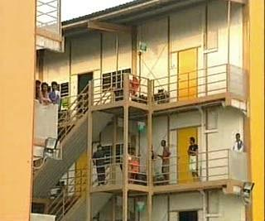
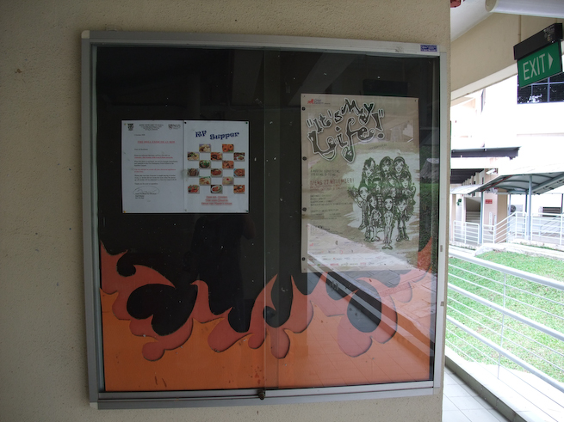
Posters - Placement
At all their dorms, preferably on the toilet doors
On notice boards
Notes:
NN

Slide 14
Facebook page by Ming
A Facebook page will be set up titled “Ask Ming”
Why FB page?
People would be able to ask Ming any questions they have
Makes MOM more approachable
Bridges the workers and MOM together through Ming.
Notes:
JY

Slide 15
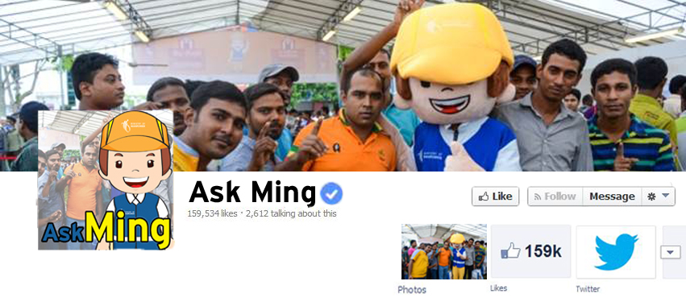
How to attract people to ‘like’ Ming?
Notes:
JY

Slide 16
‘Guess The Photo’ - Phase #1: Ming releases a pixelated photo
Guess the picture
First 10 people to answer will get featured on ‘Ask Ming’ Page
Notes:
JY

Slide 17
Phase #2: Ming reveals the answer
Reveals the answer
Announce the winners
Gives facts relating to the image
If you are working at a construction site, do remember to wear a construction helmet when you’re on the site.
Notes:
JY

Slide 18
Objective 2:
Increase the number of visitors to the MOM Roadshow 2014
Notes:
S

Slide 19
Facebook Advertising
Why Facebook ads?
To cater to their online habits
To spread awareness of the event
Observations: FWs spends most of their time on Facebook and YouTube
Notes:
S

Slide 20
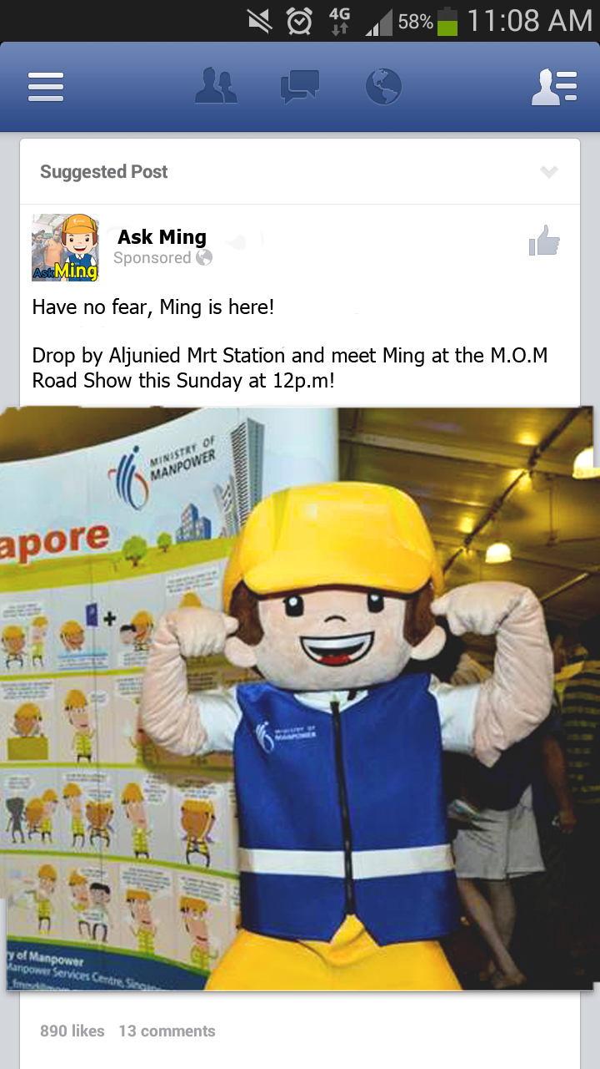
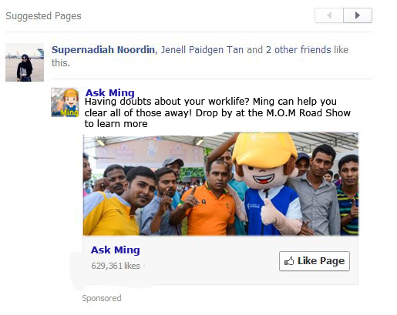
Notes:
S

Slide 21
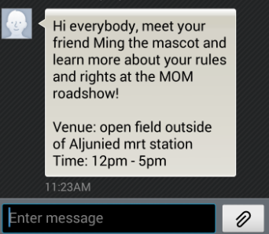
SMS Blast
Sent out to the foreign workers a few days before the event.
This is to keep their memory of the event fresh in their mind.
Why SMS blast?
More direct
Known to use their phones very often
Notes:
Y

Slide 22
Objective 3:
Educate about the employment regulations, their rights and responsibilities
Notes:
NN

Slide 23
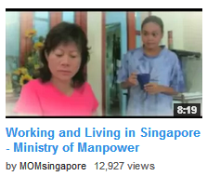
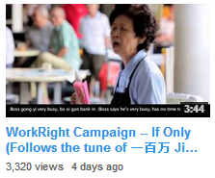
Video Creation
Create a video to promote the message of MOM that will be placed on MOM’s YouTube page
Why this idea?
Engaging way to attract people and spread the campaign message more
Make use of the viewers MOMsingapore YouTube page
Notes:
NN

Slide 24
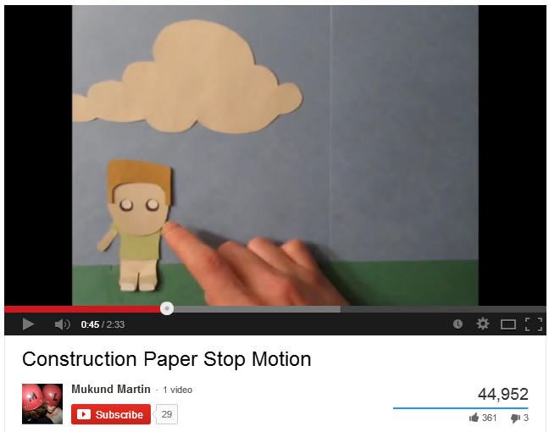
Idea: Paper Stop Motion
Notes:
NN

Slide 25
Video Idea: Story outline
“Main character, Bob has been working overtime and his boss notices but takes advantage of it. Bob tells Ming that he is not paid overtime so Ming tells him that he has to stand up for his right and also remind him of the conditions of working overtime.”
Ming
Bob
Mr. Boss
Notes:
NN

Slide 26
M.O.M Roadshow
Held every year by M.O.M
Purpose: To inform and educate foreign workers about the messages and rules they have to follow
Notes:
S

Slide 27
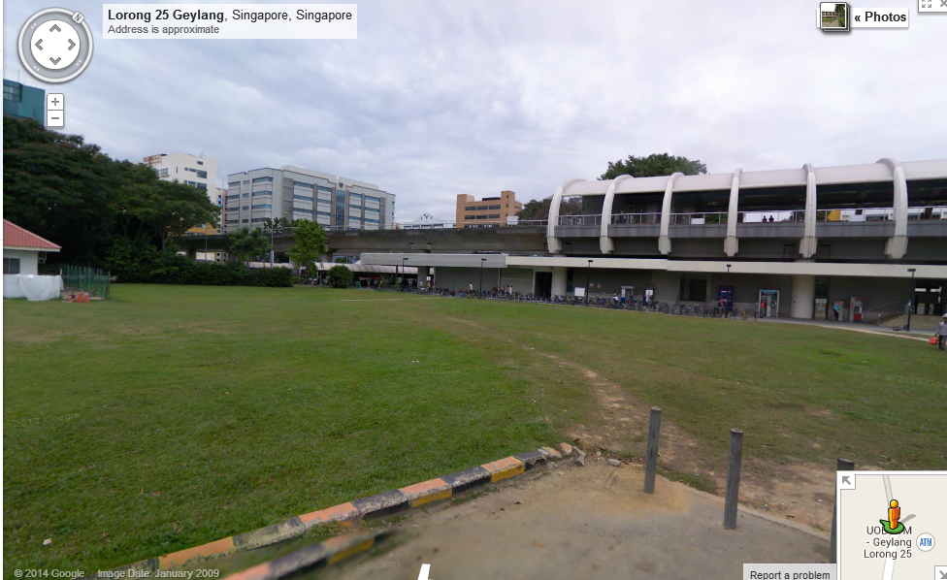
Venue: Open field next to Aljunied MRT station
Time: 12 noon - 5pm
Notes:
S

Slide 28
Highlights of the Roadshow
Sign Boards
Stage performa-nces
Goodie Bags
Game Booths
Workers dressed as Ming
Notes:
S – Click on Game booths and goodie bags

Slide 29
‘This’ or ‘That’
Players will be given two scenarios
THIS?
Scenario 1
THAT?
Scenario 2
Players will have to guess which scenario is right.
When they get two correct, they get a prize.
Notes:
One scenario will depict the wrong thing to do and the other will depict the right thing to do at work.

Slide 30
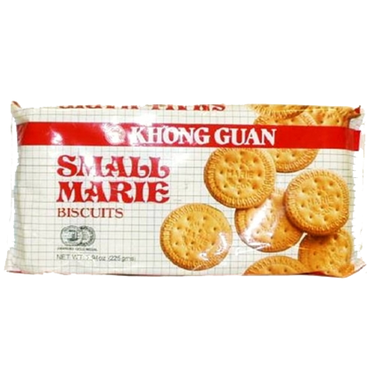
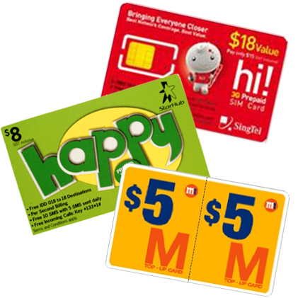
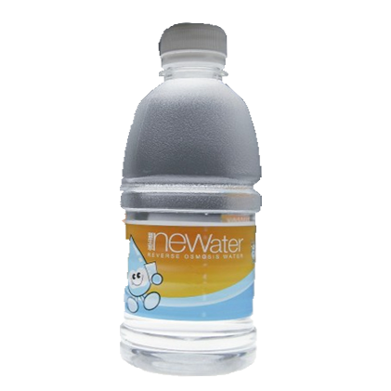
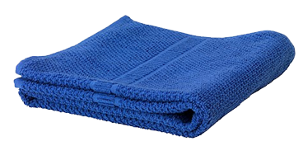

Slide 31
Ming says:
THANK YOU
for your time and kind attention
Feel free to ask any questions!
Notes:
S

